Slide 1


Credit Card Fraud Detection
By- Diptirtha Chatterjee, Dhiraj Kumar,
Prasoon Singh Patel, Shailendra Nath Yadav
DST - CIMS BHU

Slide 2
What is ‘Fraud’?
‘Fraud’ itself a word that belongs to something unlawful and un authorized. Fraud involves false representations of facts, whether by intentionally withholding important information or providing false statements to another party for specific purpose for gaining something that may not have been provided without the deception. Type of Fraud include tax fraud, Credit card fraud, wire fraud, securities fraud and bankruptcy fraud.
Definition: Fraud is intentionally deception action designed to provide the perpetrator with an unlawful gain or to deny a right to a victim.

Slide 3
Why To Detect Fraud Transactions?
In this modern era where everything is online, making a transaction is not safe anymore, so it is duty of every bank to check the transaction details and analyze them whether it’s a fraud transaction or not which is not an easy task and very time consuming. In the era where time is money, here comes Data Science and Machine Learning algorithm to rescue us from this vital problem. This project includes to give a complete view how to solve this problem using very sophisticated Machine Learning algorithm with Credit Card Fraud Detection, which includes modelling with the past records of Credit Card Transactions with the ones who have the Fraud Transactions. Here we want to classify all the correct Fraud Transactions to avoid any misclassifications. In this project, first we have focused in data pre-processing and data transformation, then we have performed various Classification algorithm to get a model having maximum accuracy score

Slide 4
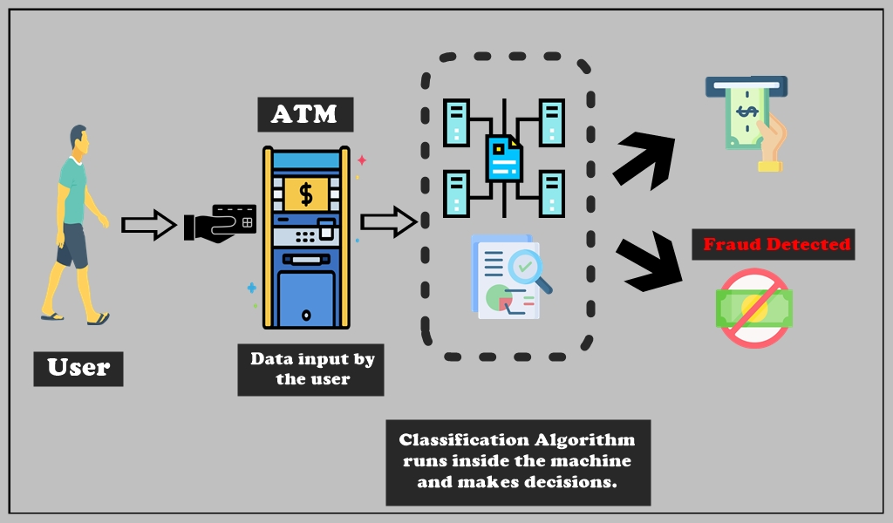
How does the process work?
These steps are followed by any bank while authorizing any transaction:
User goes for transaction
Automated System receives a transaction request
Uses ML algorithm to make decisions
Fraud = Decline Transaction Genuine = Accept Transaction

Slide 5
What we can do?
There are several Machine Learning Algorithm which can be used to detect the fraud transactions. We have used some of them in this project. They are –
Logistic Regression
K – Nearest Neighbours
Naïve Bayes
Support Vector Machine
Random Forest
Artificial Neural Network

Slide 6
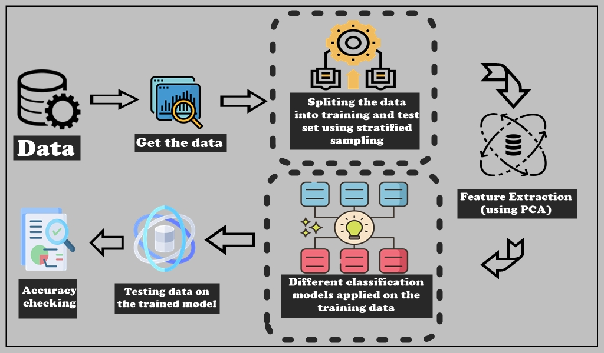
Project View

Slide 7
Few Terminologies!
PCA: It’s a dimensionality reduction technique used while we have large number od features in our dataset. It transforms the features into lesser number so that we can capture a significant amount of total variability in the dataset.
Logistic Regression: It’s a statistical model which gives a linear boundary to classify the predictor variable very efficiently. As it gives linear boundary, sometimes there is a chance of misclassification.
K-Nearest Neighbors: It’s a nonparametric Supervised Machine learning algorithm used for classification. It calculates the distances of new data point from the k nearest neighbors and count the number of data point in each category. Assign the point to that class which have counted the most neighbors.
Naïve Bayes: It’s a collection of classification algorithms based on Bayes theorem. It used the probability of dependent variable given that all the independent variables have already occurred. Based on the probability, it classifies the dependent variable.

Slide 8
Support Vector Machine: It’s a supervised machine learning algorithm used for Classification and regression both. Here we have used Radial basis function to classify the dependent variable. Radial Basis Kernel is a kernel function that is used in machine learning to find a non-linear classifier or regression line.
Random Forest: It’s one of the mostly used Supervised Machine learning algorithm for classification. Random forest is formed through a bunch of decision tree. Decision tree is collection rules through which classification is made. Using more than one decision trees, make the prediction stable and strong.
Artificial Neural Network: An Artificial Neural Network is an information processing technique. It works like the way human brain processes information. ANN includes a large number of connected processing units that work together to process information. They also generate meaningful results from it.

Slide 9
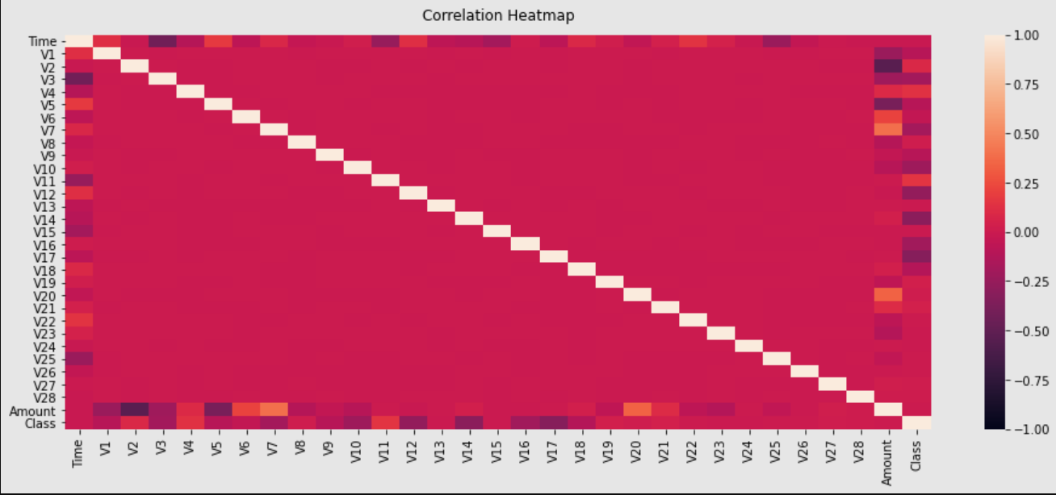
Dataset – Introduction & EDA
We have found the dataset for our analysis from Kaggle which is one of the most used platforms by the future Data Scientists. Our dataset has 31 columns out of which 28 are named as v1-v28. Others are ‘Time’, ‘Class’, ‘Amount’. ‘Time’ represents the time gap between the transactions on the dataset. ‘Amount’ is the amount of money that had been withdrawn or transferred. ‘Class’ has two values ‘0’ and ‘1’ where ‘0’ represents a genuine transaction and ‘1’ represents a fraud one.

Slide 10
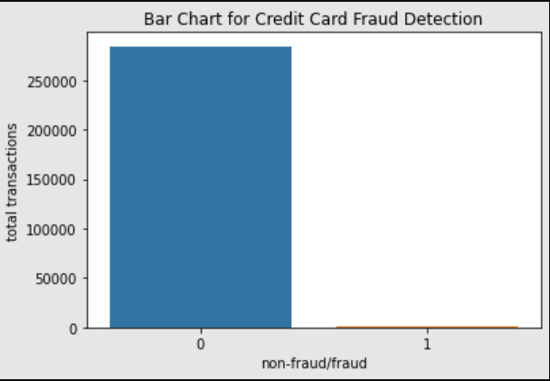
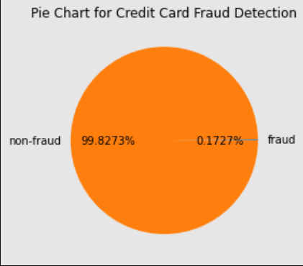
Graphical Analysis of Target Value

Slide 11
Findings from the Analysis
Logistic Regression: Support Vector Machine:
K-Nearest Neighbours: Random Forest :
Naïve Bayes: Artificial Neural Network:
 | Predicted No | Predicted Yes
Actual No | 56854 | 10
Actual Yes | 37 | 61
 | Predicted No | Predicted Yes
Actual No | 56862 | 2
Actual Yes | 36 | 62
 | Predicted No | Predicted Yes
Actual No | 56860 | 4
Actual Yes | 28 | 70
 | Predicted No | Predicted Yes
Actual No | 56862 | 2
Actual Yes | 33 | 65
 | Predicted No | Predicted Yes
Actual No | 55666 | 1198
Actual Yes | 18 | 80
 | Predicted No | Predicted Yes
Actual No | 56844 | 17
Actual Yes | 17 | 84

Slide 12
Accuracy Score Comparison
Conclusion:
Credit card fraud detection is a mostly used machine learning problem no doubt. We have used some of the common techniques of Machine learning algorithm. We have got 99.94% accuracy by ANN classifier which is no doubt a great accuracy for this kind of serious crime detection problem. In Random Forest classifier we have got 34 misclassifications which is negligible to the seriousness of this problem. If we put more data in this algorithm, we expect to get more accurate predictions.
Name of Classifier | Accuracy Score
Logistic regression | 0.999175
K-nearest neighbors | 0.999386
Naïve Bayes | 0.978652
Support vector machine | 0.999333
Random forest | 0.999386
ANN | 0.999403

Slide 13
Future Enhancement
However, we have reached a very good accuracy, it’s not the end. We will try our best to improve the model to get 100% accuracy where our model can classify correctly the valid and fraud transactions without having any false prediction.
We will also add some more sophisticated algorithms to make the predictions more accurate in future.
More data always increases the precision of any algorithm. We will also try to predict this problem with more data. However, this needs some official supports from banks to face the real-life data problems.

Slide 14
References
Analysis of Credit Card Fraud Detection Techniques. (2016b). International Journal of Science and Research (IJSR), 5(3), 1302–1307.
Shimpi, P. R. (2016b). Survey on Credit Card Fraud Detection Techniques. International Journal Of Engineering And Computer Science. Published.
Padvekar, S. A., Kangane, P. M., & Jadhav, K. V. (2016). Credit Card Fraud Detection System. International Journal Of Engineering And Computer Science. Published.
C., D. V. P. (2020). Analysis of Performance on Classification Algorithms for Credit Card Fraud Detection. Journal of Advanced Research in Dynamical and Control Systems, 12(SP3), 1403–1409.

Slide 15
Animation Video
Video link: https://drive.google.com/drive/folders/1HPw4YL88EVB7AtrwOfUn88r_JK-wTXqb?usp=sharing

Slide 16
THANK YOU ALL
FOR YOUR PATIENCE
Looking forward for the feedback!☺

